Slide 1
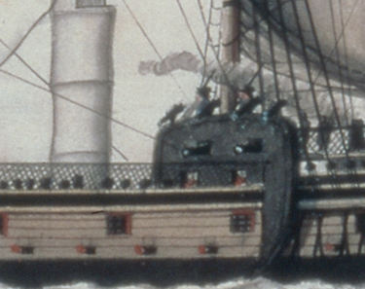
The Transatlantic Slave Trade In Defence of Freedom
Curated Classroom

Slide 2
As a Curator in a Museum, which 5 objects are essential to include in the new exhibition: The Transatlantic Slave Trade ‘In Defence of Freedom’

Slide 3
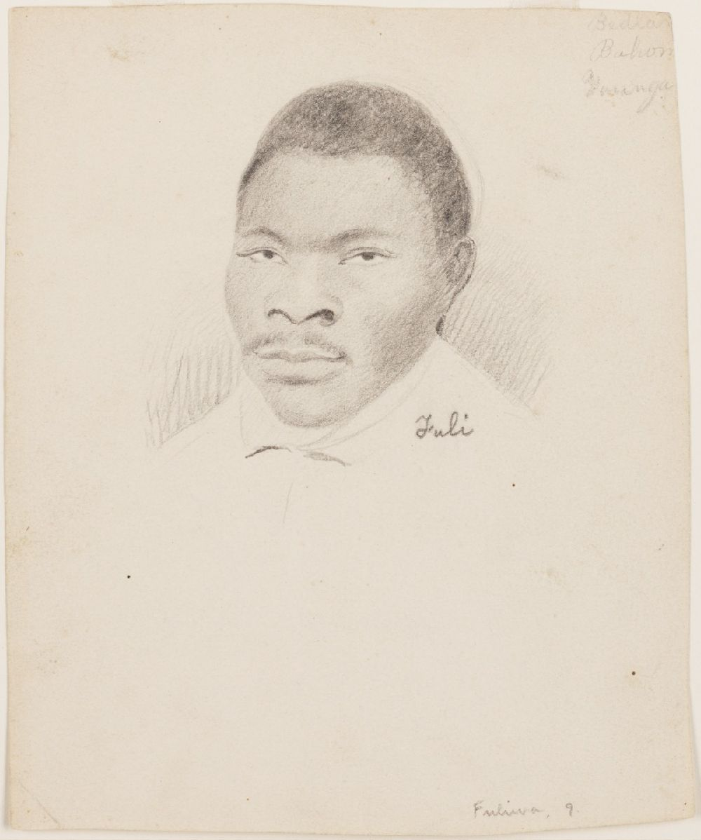
Title of object: Fuli
Sketches of the Amistad captives
Pencil Drawing
Creator: Drawn from life, by Wm. H. Townsend
Date Published / created: ca. 1839-1840
Why it is an important historical object / document:
Copyright information: collections.library.yale.edu

Slide 4
cowperandnewtonmuseum.org.uk
www.museumand.org

